Slide 1
Climatewins machine learning interim report
Presented by Josh Wattay
August 19, 2024

Slide 2
ahead of the curve
Machine learning makes an impact in our climate data.

Slide 3

Climate wins vision
Cimate Wins is interested in using machine learning to help predict the consequences of climate change around Europe and, potentially, the world.
It’s been sorting through hurricane predictions from The National Oceanic and Atmospheric Administration (NOAA) in the U.S., typhoon data from The Japan Meteorological Agency (JMA) in Japan, world temperatures, and a great deal of other data.

Slide 4
Exploratory questions
How is machine learning used?
Machine Learning employs algorithms to automate tasks and foster interactive experiences between technology and users by analyzing vast troves of data.
Is it applicable to weather data?
Machine learning has been applied to weather data for over 25 years, with uses in weather and climate modeling. By identifying patterns in historical data, ML holds promise to enhance weather forecasting with greater precision.
ClimateWins has heard of ethical concerns surrounding machine learning and AI. Are there any concerns specific to this project?
The accuracy and reliability of AI algorithms are directly tied to the quality and representativeness of the training data. If the data used to train these algorithms is biased, it can lead to biased decision-making. This is a significant concern, as AI algorithms are only as unbiased as the data they are trained on.

Slide 5
Exploratory questions (continued)
Historically, what have the maximums and minimums in temperature been?
The maximum recorded temperature with this data was 43.6° C on July 24, 2007.
The minimum recorded temperature was -34.3° C on January 13, 1968.
Can machine learning be used to predict whether weather conditions will be favorable on a certain day? (If so, could it be possible to predict danger.)
Yes, ML can be used to predict weather conditions as favorable or dangerous on a certain day. As will be demonstrated later in this presentation, our K Nearest Neighbors model predicts pleasant weather with an 88% rate of accuracy. While not perfect, with more iterations and training of this model, it is reasonable to assess that weather conditions can be predicted by ML models.

Slide 6

Agenda
Objective & Hypotheses
Addressing Data Source & Bias
Optimization Techniques
Supervised Machine Learning
Recommendation

Slide 7

Objective
Use machine learning to help predict the consequences of climate change.

Slide 8
hypotheses
Machine Learning aided the evaluation of these hypotheses:
The average temperature has changed over time since the weather stations started collecting data and we can accurately forecast that change for the future.
It is possible to predict how many pleasant days and unpleasant days of weather a location will experience.
Patterns between the variables can be investigated further in order to discover unknown or hidden correlations and relationships.

Slide 9
Data source and bias
The data used for this report was provided by the European Climate Assessment & Dataset. The data sets can be downloaded by using this link.
There are regional and cultural biases in climate change that can be exacerbated by the use of machine learning. If the model is not trained properly and predicts a rapid increase in temperature in the next 12-24 months, then there is a lot at stake for both those who believe strongly in the impacts of climate change (confirmation bias) and those who deny it (falsification bias).
The data in this set is also subject to temporal and location bias, since it was only gathered in Europe and for a period of time that may no longer be representative of the present.

Slide 10

Optimization techniques
Gradient Descent Method
The gradient descent algorithm was used to optimize this data set. Gradient descent is a simple technique for finding a local minimum (or valley) that can be applied to both linear and nonlinear cases.
We leveraged gradient descent to minimize the error by adjusting the number of iterations and the step size (alpha), which were varied as needed. By tuning the theta0 and theta1 parameters, as well as the number of iterations and step size, we were able to achieve a result very close to 0.

Slide 11
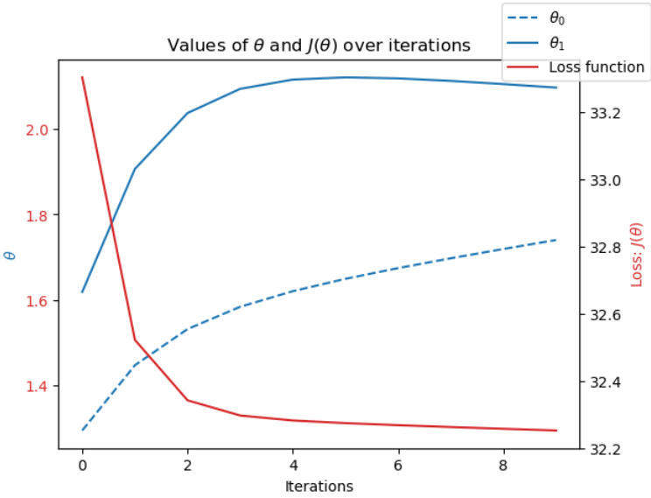
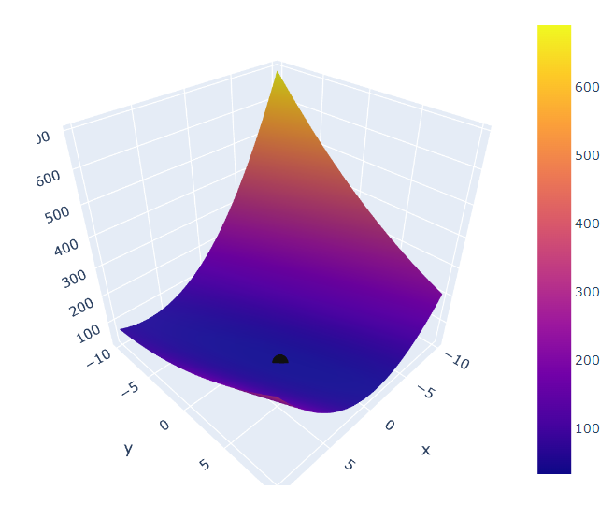
Gradient descent results
Example of Gradient Descent Results : Oslo 1960
Weather Station | Year | Theta0 | Theta1 | Iterations | Step Size
Roma | 1960 | 5 | 5 | 10 | 0.1
Roma | 1985 | 5 | 5 | 10 | 0.1
Roma | 2000 | 5 | 5 | 10 | 0.1
Budapest | 1960 | 4 | 3 | 10 | 0.1
Budapest | 1985 | 4 | 3 | 10 | 0.1
Budapest | 2000 | 4 | 4 | 10 | 0.1
Oslo | 1960 | 2.1 | 1.7 | 10 | 0.1
Oslo | 1985 | 1.7 | 1.1 | 10 | 0.1
Oslo | 2000 | 2 | 2 | 10 | 0.1

Slide 12
accuracy
Three supervised machine learning models (K Nearest Neighbor (KNN), Decision Tree (DT), and Artificial Neural Networks (ANN) were introduced in order to determine the most accurate model for the data.
The K Nearest Neighbor method has been the most accurate model for predicting pleasant weather conditions at this point in the testing.
The Sonnblick weather station has been overfitted with 100% accuracy. I believe this is due to the location of the weather station being on the top of the Austrian Alps. This is the only station with 100% accuracy at the moment.
The absence of Precipitation, Cloud Cover, and Wind Speed may have an impact on the accuracy of the model. For example, if the temperature is within what the model considers to be a pleasant range, but on that same date there was 3” of rainfall, then the model is not accounting for that variable and predicting that this day is pleasant, even though it was not due to the rain.

Slide 13
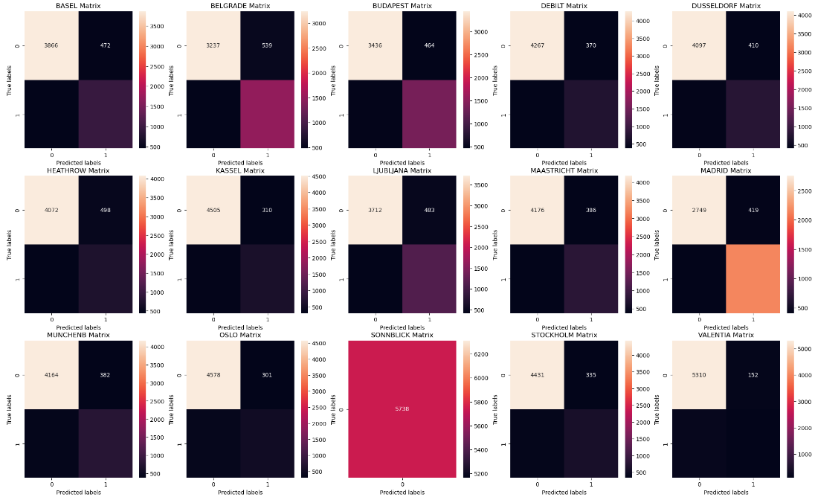
K Nearest Neighbor (KNN)

Slide 14
K Nearest Neighbor (KNN)
Station | Accurate Prediction |  | False (+) | False (-) | Accuracy
BASEL | 3866 | 949 | 472 | 451 | 84%
BELGRADE | 3237 | 1482 | 539 | 480 | 82%
BUDAPEST | 3436 | 1361 | 464 | 477 | 84%
DEBILT | 4267 | 716 | 370 | 385 | 87%
DUSSELDORF | 4097 | 798 | 410 | 433 | 85%
HEATHROW | 4072 | 728 | 498 | 440 | 84%
KASSEL | 4505 | 590 | 310 | 333 | 89%
LJUBLJANA | 3712 | 1122 | 483 | 421 | 84%
MAASTRICHT | 4176 | 803 | 386 | 373 | 87%
MADRID | 2749 | 2163 | 419 | 407 | 86%
MUNCHENB | 4164 | 771 | 382 | 421 | 86%
OSLO | 4578 | 500 | 301 | 359 | 88%
SONNBLICK | 5378 | N/A | N/A | N/A | 100%
STOCKHOLM | 3875 | 530 | 891 | 442 | 77%
VALENTIA | 3588 | 147 | 1874 | 129 | 65%

Slide 15
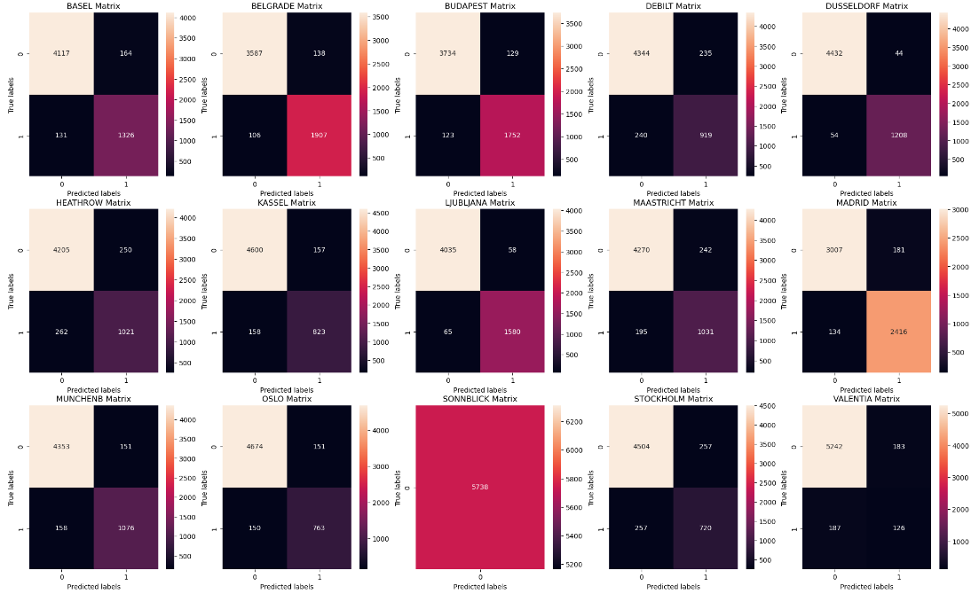
Decision tree (dt)

Slide 16
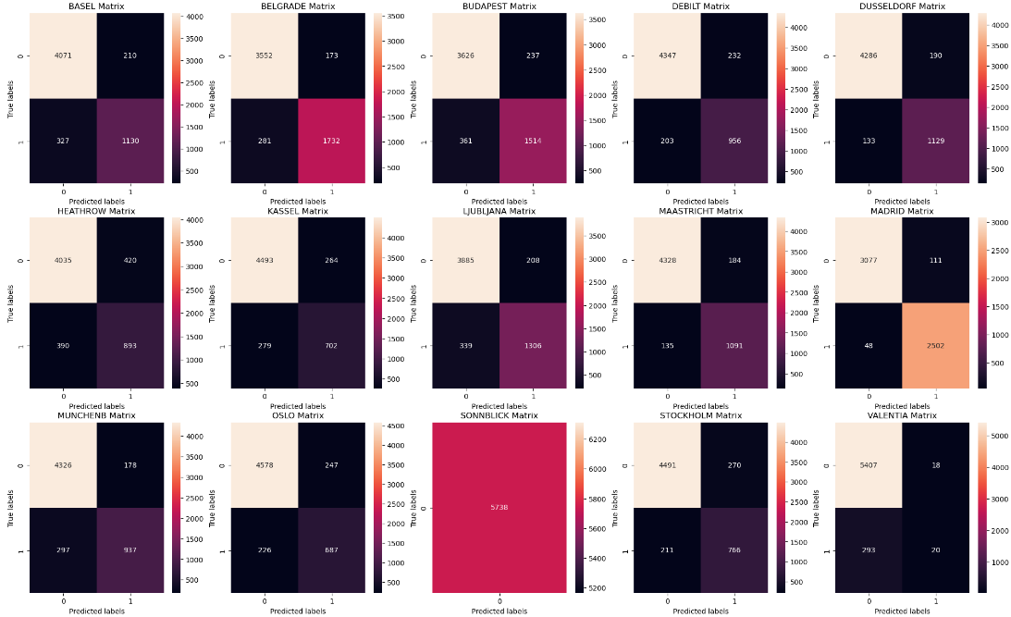
Artificial neural network (ann)
Scenario 1 - Confusion Matrix – mlp = MLPClassifier(hidden_layer_sizes=(15, 10, 5), max_iter=1000, tol=0.00001)

Slide 17
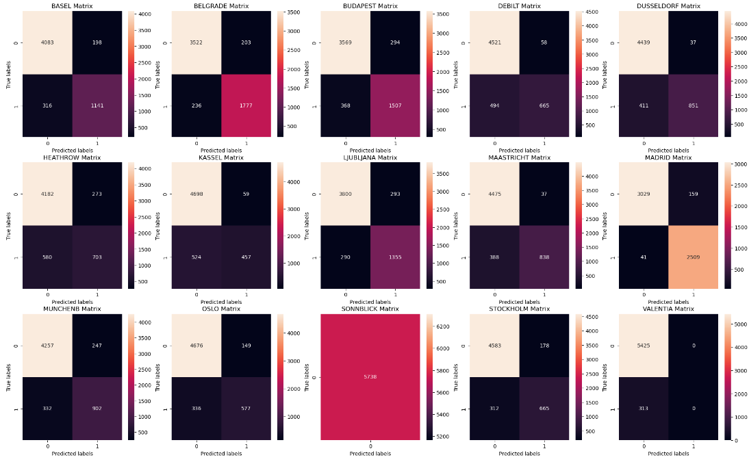
Artificial neural network (ann)
Scenario 2 Confusion Matrix - mlp = MLPClassifier(hidden_layer_sizes=(20, 10, 5), max_iter=1500, tol=0.00001)

Slide 18
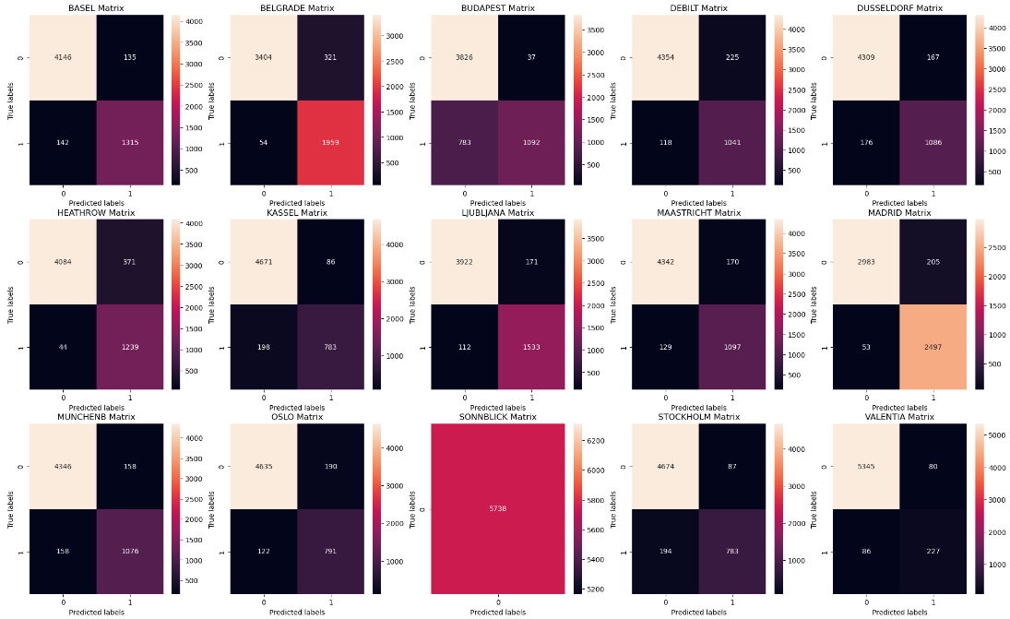
Artificial neural network (ann)
Scenario 3 Confusion Matrix - mlp = MLPClassifier(hidden_layer_sizes=(100, 50, 25), max_iter=5000, tol=0.00000000001)

Slide 19
recommendation
I recommend that Climate Wins use the KNN model for predicting pleasant weather. It has performed the best, is relatively efficient and inexpensive compared to the Decision Tree and Artificial Neural Network (ANN) models, and if we account for other variables moving forward, it should be able to perform above 95% accuracy.
With only a 60% train accuracy and 53% test accuracy, the Decision Tree needs more criteria to more accurately classify pleasant and unpleasant weather patterns.
With more iterations the Artificial Neural Network (ANN) model does have the ability to become quite accurate (>95%) however, this will require significantly more resources than the KNN model.

Slide 20





Thank you
Josh Wattay
jawattay@gmail.com

